Slide 1
PowerShell
Becoming immediately effective
Presented by Jason Helmick, Jeff Hicks, & Sean Wheeler

Slide 2



Jason Helmick
Jeff Hicks
Sean Wheeler
PowerShell PM - Microsoft
Author, teacher, automation specialist
PowerShell docs - Microsoft

Slide 3
Where can I get the slides?
https://github.com/theJasonHelmick/SpiceWorld

Slide 4

Agenda
Don’t fear the shell
Installing PowerShell 7
Discovering useful commands
Getting help – Docs
Interactive versus Automation
Intelligent Shell
Advanced Features

Slide 5

Don’t fear the shell
Native Commands work
Windows, macOS and Linux
Notepad, calc, ping, ipconfig, ifconfig, mspaint
Common commands work!
dir, cls, type, help == ls, clear, cat, man
PowerShell commands (cmdlets)
Verb–Noun - DoWhat–ToWho
Aliases dir, cls, type, help – Get-Alias
Help!
Get-Help, Get-Command
Drive to your destination
Get-PSdrive
Notes:
## Don't fear the shell - Jason (Intros + Don't Fear - 20 min)
- Native command
- Verb-Noun
- Aliases
- Help & Get-Command
- Using PSDrives

Slide 6

So, why is PS 7 not in Windows?
Notes:
- Why is it not in Windows? - Jason

Slide 7
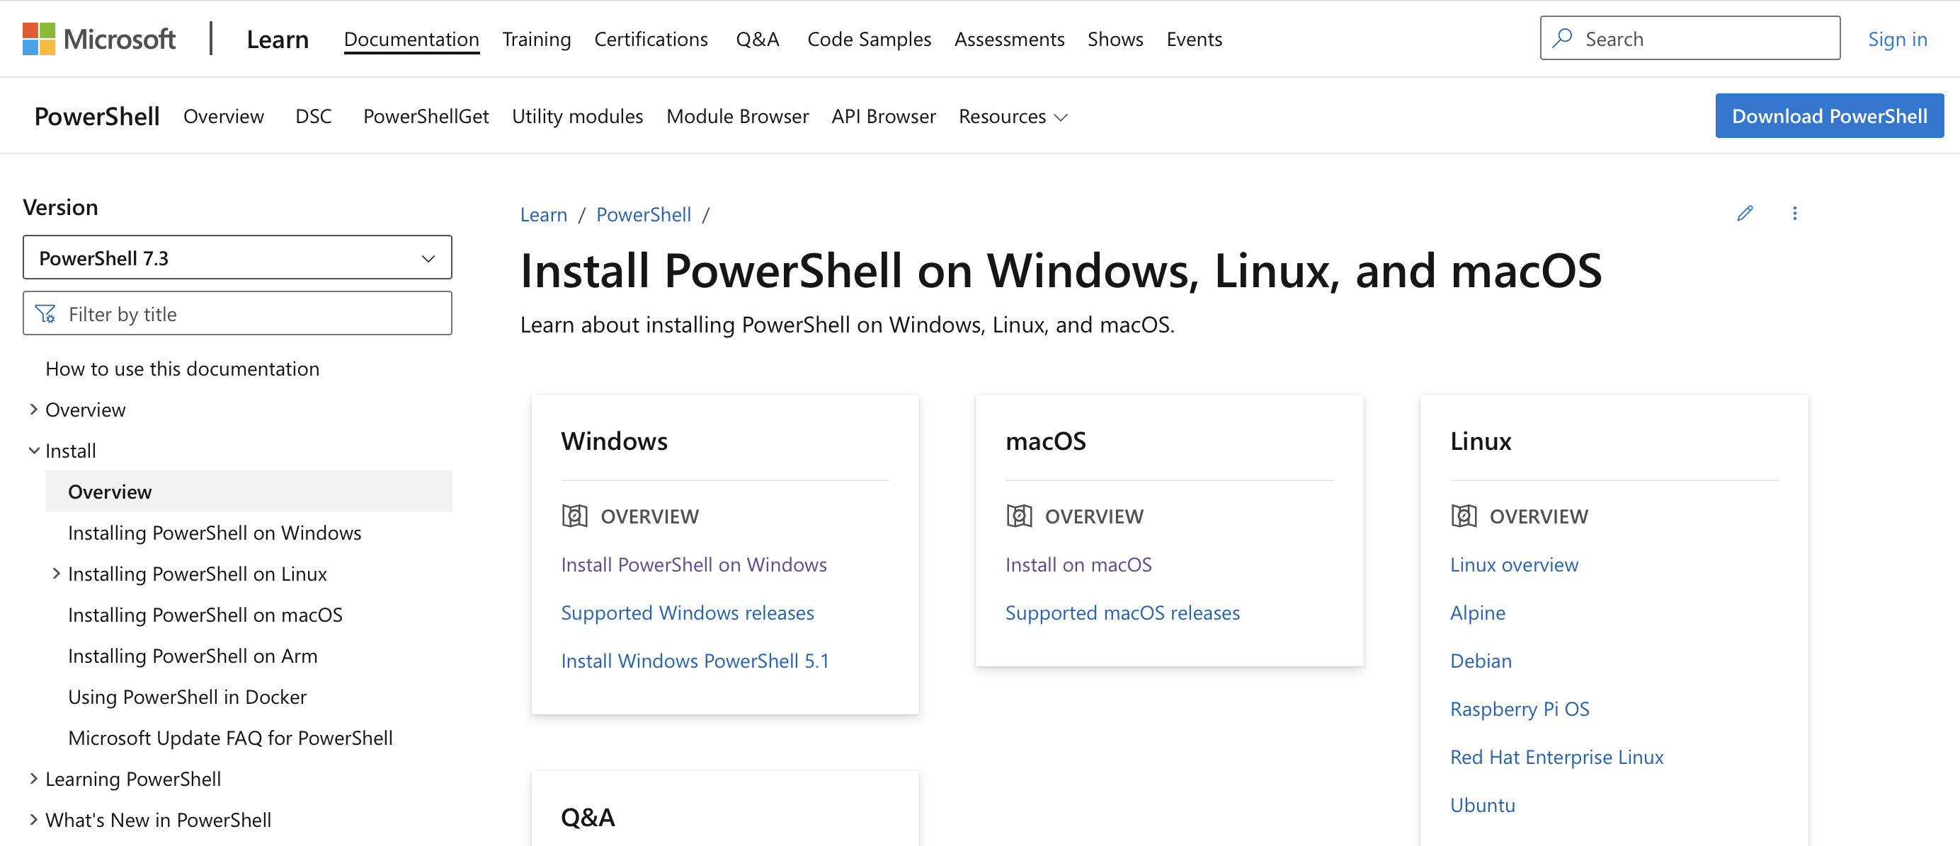
Installing PowerShell 7
https://learn.microsoft.com/powershell/scripting/install/installing-powershell
Notes:
## Installing PowerShell 7 - Sean - 15 min
- See install docs
- Github Assets - click download button and show assets
- Side-by-side with PS5.1
- [Migrating from Windows PowerShell 5.1 to PowerShell 7](/powershell/scripting/whats-new/migrating-from-windows-powershell-51-to-powershell-7)
- [Differences between Windows PowerShell 5.1 and PowerShell 7.x](/powershell/scripting/whats-new/differences-from-windows-powershell)
- [Release history of modules and cmdlets](/powershell/scripting/whats-new/cmdlet-versions)
- [about Windows PowerShell Compatibility](/powershell/module/microsoft.powershell.core/about/about_windows_powershell_compatibility)

Slide 8
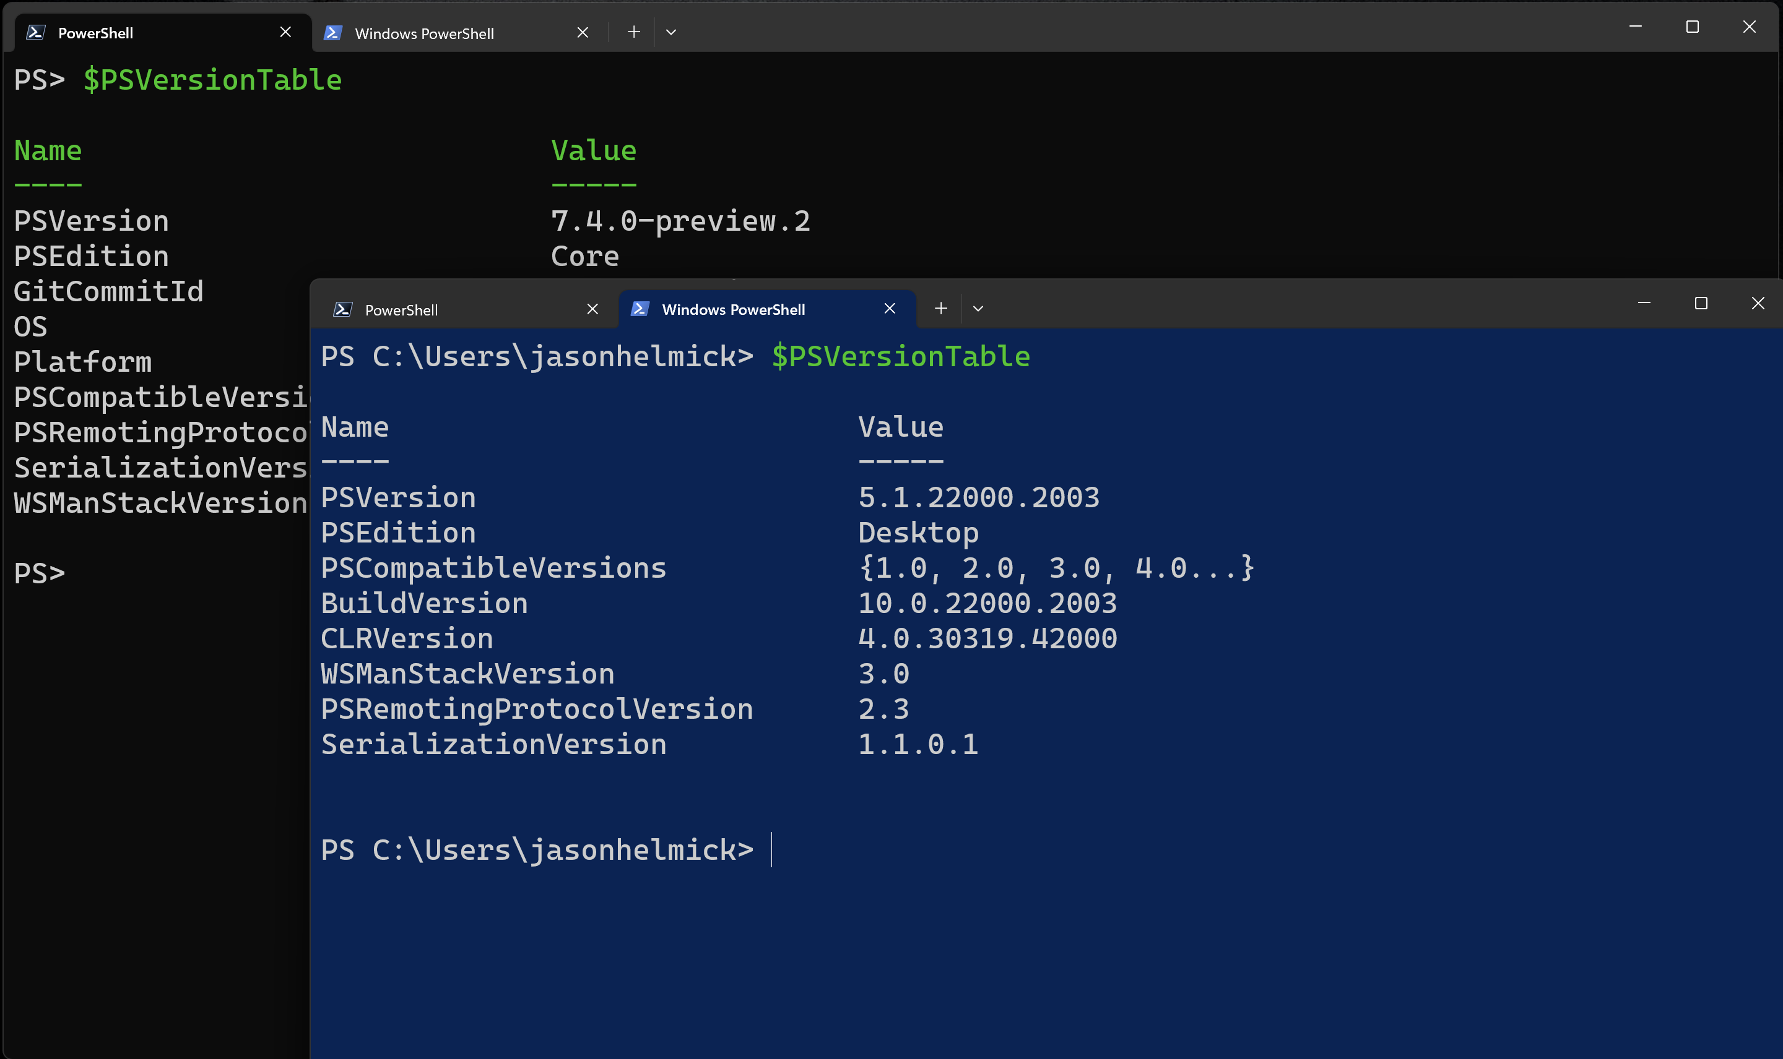
PowerShell versions side-by-side

Slide 9
Command discovery
Modules!
Built-in
Ships with MS Products
The PowerShell Gallery
Finding commands on your system
Get-Command, Get-Module, Import-Module
Finding modules to install
Module browser
PowerShell Gallery
Using PSResourceGet or PowerShellGet
Notes:
## Command discovery - Jeff/Jason/Sean - 20 min
- Module Overview -Jason
- Built-in
- Ship with MS Products (Windows, SQL, etc.)
- Intro PSGallery
- Finding commands on your system - Jeff
- Get-Command
- Module commands - get-module, import-module
- Finding modules to install - Sean
- Module Browser
- https://learn.microsoft.com/en-us/powershell/module/
- PS Gallery search
- https://www.powershellgallery.com/
- PSResourceGet - https://learn.microsoft.com/powershell/module/microsoft.powershell.psresourceget/?view=powershellget-3.x

Slide 10

Help!
PowerShell Help System
Get-Help and Update-Help
Understanding Syntax
Online documentation
How to find help
Other support options
StackOverflow, Discord/Slack, Spiceworks, PowerShell.org
PowerShell blogs
Notes:
## Help & Docs - Sean - 20 min
- PowerShell Help System
- Get-Help and Update-Help
- Understanding Syntax
- Online documentation
- How to find help
- Other help options - https://learn.microsoft.com/powershell/#community-resources
- StackOverflow, Discord/Slack, Spiceworks, PowerShell.org
- https://community.spiceworks.com/programming/powershell
- https://aka.ms/psslack
- https://aka.ms/psdiscord
- PowerShell blogs

Slide 11
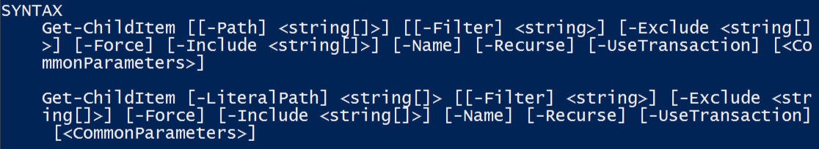
Understanding Syntax
Parameter sets
The meaning of Syntax
Marker | Meaning
- | This is a parameter
< > | This is an argument
[ ] | Argument accepts multiple values
[-Param] | Parameter is positional
[-Param <Arg>] | Parameter is optional

Slide 12
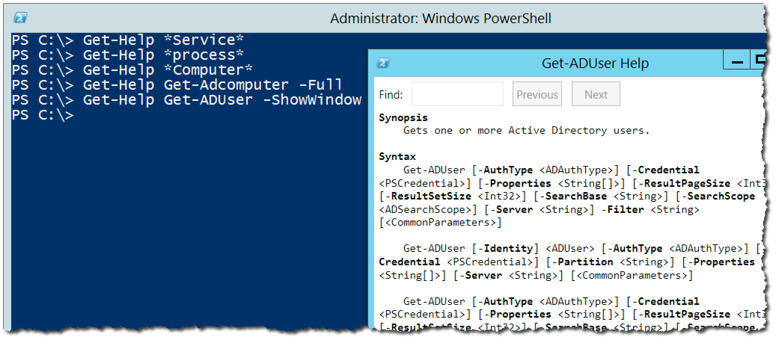
Real-World using Help

Slide 13
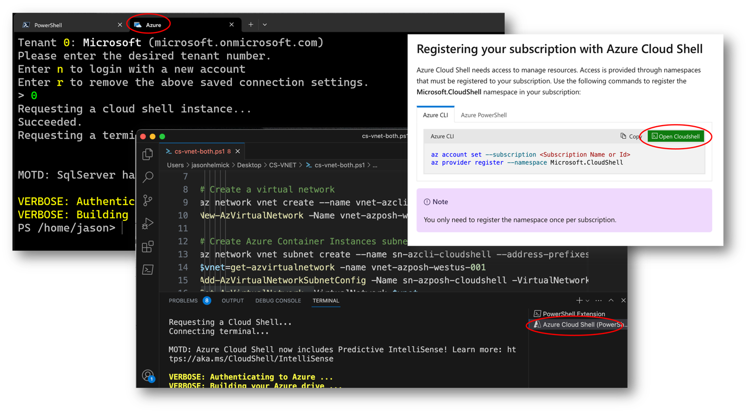
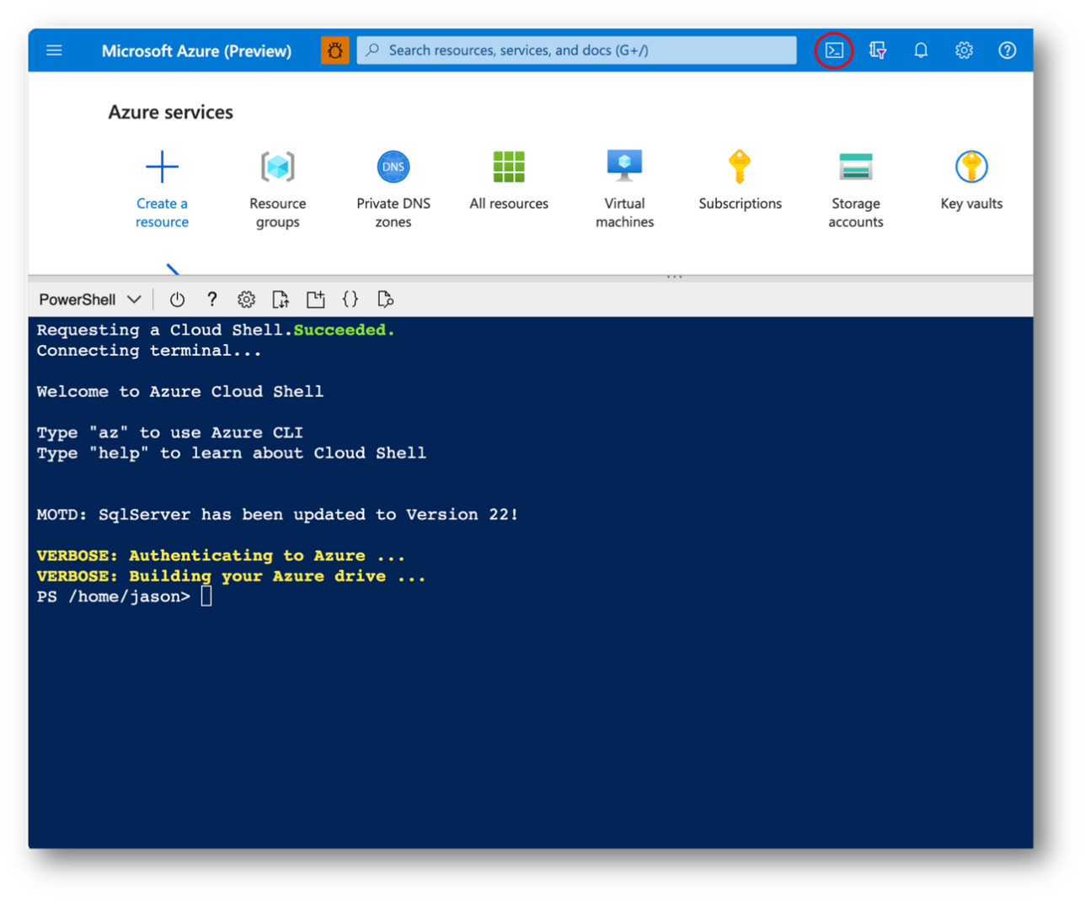
Interactive versus Automation
Notes:
## Interactive vs. Automation - 30 min
- Other hosts - Jason
- Windows Terminal vs. Conhost
- VS Code
- Cloud Shell

Slide 14
Creating simple batch-style scripts
VS Code and the extension
Variables
Execution policy and unblock MoW
Come to Jeff’s toolmaking session!!!!
Notes:
- Creating simple batch-oriented scripts - Jeff
- Using VS Code & PS Extension
- Using variables
- Execution policy & unblock (mark of the web)

Slide 15
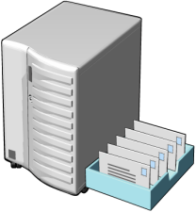









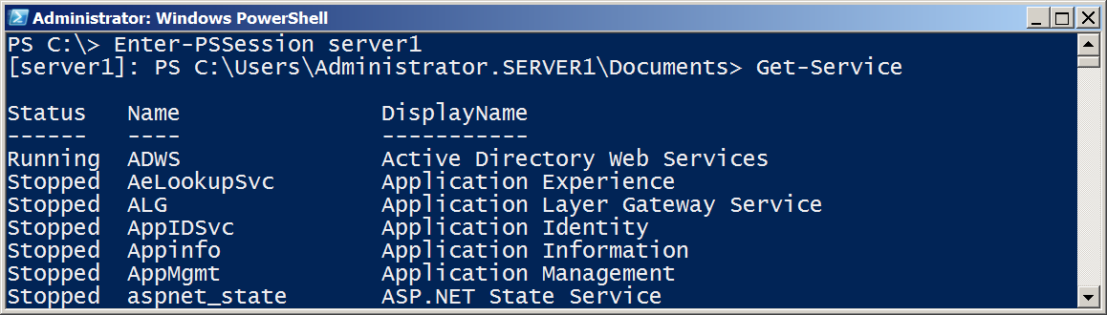
Scale-out with PowerShell remoting
Notes:
- PowerShell remoting for scale-out - Jeff
- What is it?

Slide 16
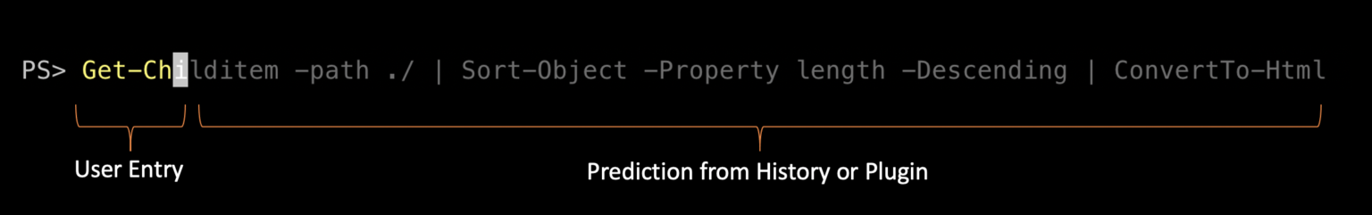
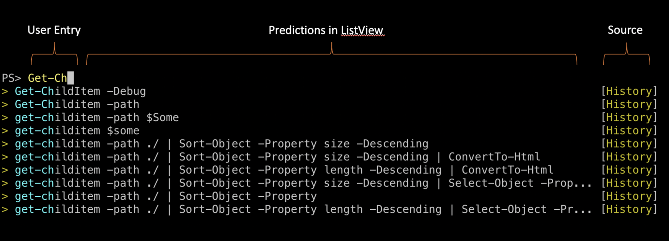
Intelligent Shell - Predictive IntelliSense and Dynamic Help
Notes:
## Intelligent shell - Jason/Sean - 30 min
- PSReadLine - Jason
- Tab completion - Jason
- Predictors - Jason

Slide 17

Making PowerShell for you - Profiles
What’s a profile?
Configuring PSReadLine

Slide 18

Profile basics
In PowerShell, the profile script is used to customize the shell environment and define functions, aliases, and variables. The profile is a PowerShell script file that is executed when you start a PowerShell session, whether it's an interactive session or a script execution.
There are different profile scripts, in different locations, for the current user and all users on the system. PowerShell runs the profile scripts in the following order.
All Users, All Hosts
All Users, Current Host
Current User, All Hosts
Current user, Current Host
No profiles in remote sessions
about Profiles - PowerShell | Microsoft Learn
Notes:
- Putting all together in your Profile - Sean
- https://learn.microsoft.com/powershell/scripting/learn/shell/optimize-shell
- What is the Profile?
- Configuring PSReadLine
- Come to Sean's session for profiles

Slide 19
Advanced fun
Alternative Credentials
Active Directory and more!
Notes:
## Advanced features - Jeff - land us - 30 min
- Using alternate credentials
- Jeff's AD examples and using PSDrives

Slide 20
More resources
Presentation archive - sdwheeler Presentation archive
PowerShell 101 | Microsoft Learn
Customizing your shell environment|Microsoft Learn
Using predictors in PSReadLine| Microsoft Learn
Using dynamic help| Microsoft Learn

